Slide 1
Aviation & Travel Demand Analytics
Machine Learning Project
Presented by: Naveen Kumar
Rahul Kumar
Millee Gupta

Slide 2
Introduction
Airline ticket prices vary significantly based on multiple factors such as airline, travel time, stops, and duration.
Understanding these factors helps passengers make cost-effective travel decisions.
This project analyzes airline flight data and builds a machine learning model to predict flight prices.
Python, statistics, and machine learning techniques are used for end-to-end analysis.

Slide 3
Objective
To analyze airline flight data using EDA and statistical methods.
To identify key factors affecting flight ticket prices.
To apply sampling and Central Limit Theorem for data understanding.
To build a machine learning regression model for price prediction.
To evaluate the model using appropriate performance metrics.

Slide 4
Dataset Overview
Dataset contains flight details collected from Goibibo.
Each row represents a single flight.
Target variable: Price
Key features:
Flight date
Airline
Flight_name
Class
From
Dep_time
To
Arr_time
Duration_min
Price
Stops
Rows and Columns: (300261, 11)

Slide 5
Tools & Technologies Used
Programming Language: Python
Libraries:
Pandas, NumPy – Data handling
Matplotlib, Seaborn – Visualization
Scikit-learn – Machine Learning
SciPy – Statistical analysis
Platform: VS Code

Slide 6
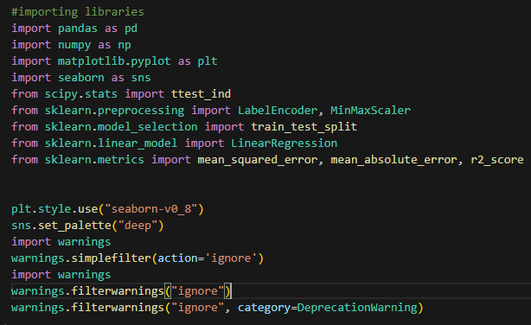

Libraries used for importing and Load the dataset

Slide 7


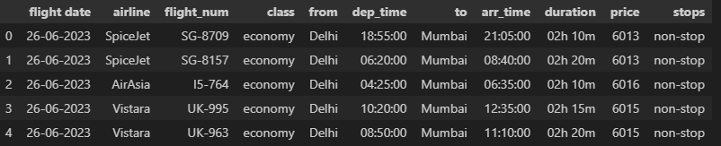
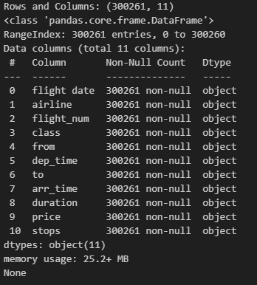
Data information

Slide 8
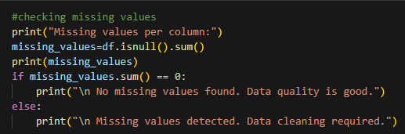
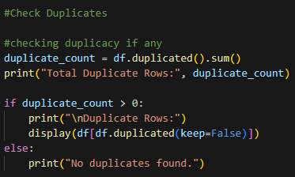
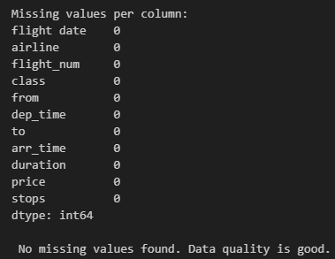
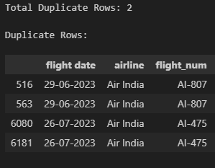



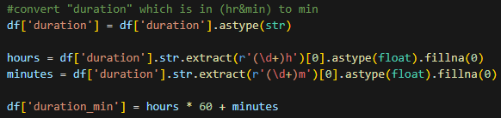
Data Cleaning & preparation

Slide 9
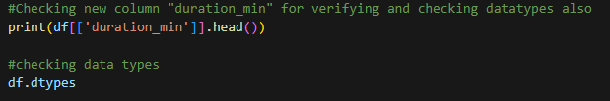
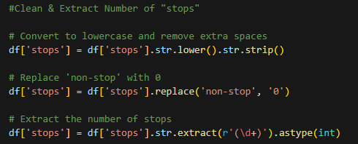
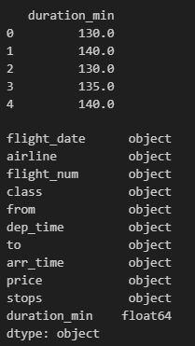

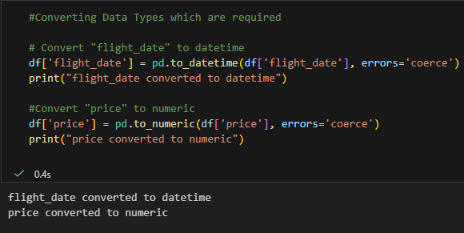



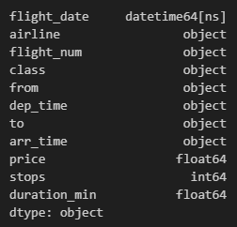

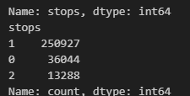



Slide 10
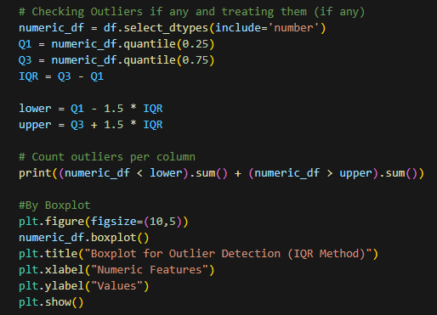
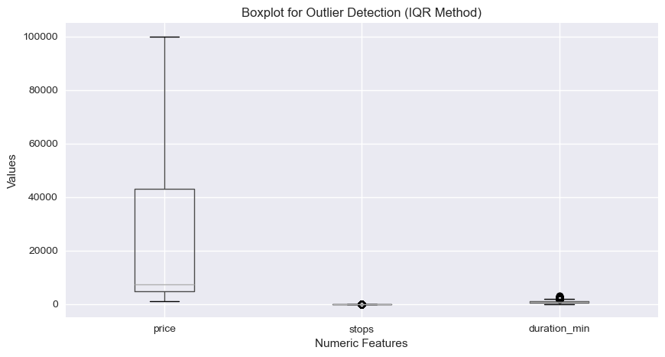

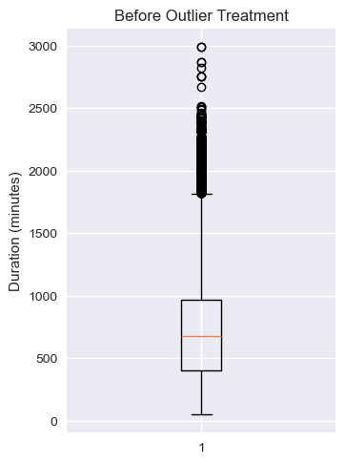
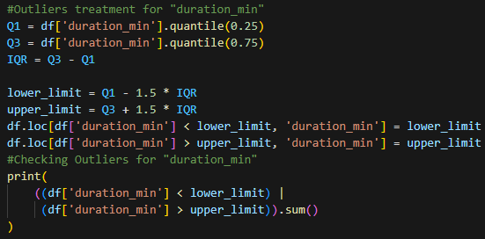
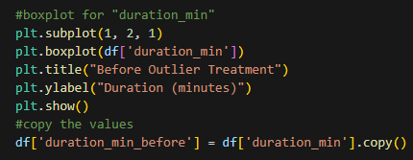

Slide 11
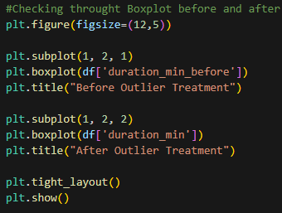


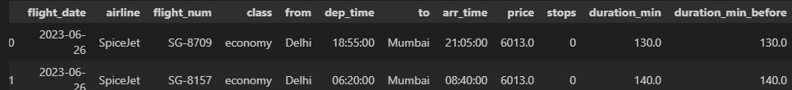
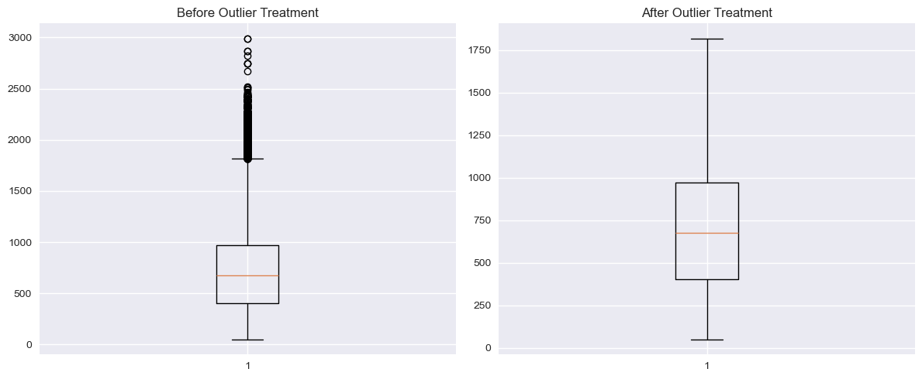

Slide 12

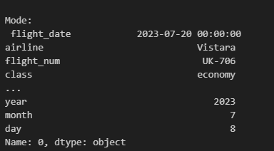
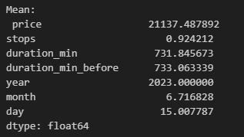
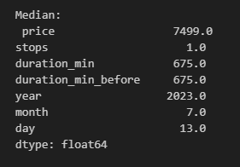
Statistics Analysis after Cleaning
Now the dataset is cleaned and saved as “cleaned_goibibo_flights_data.csv”

Slide 13
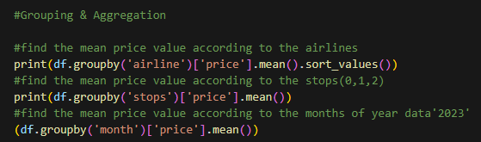
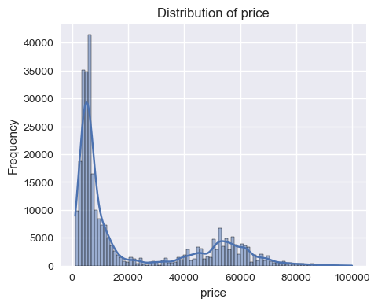
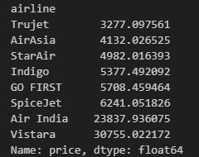
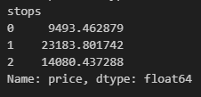
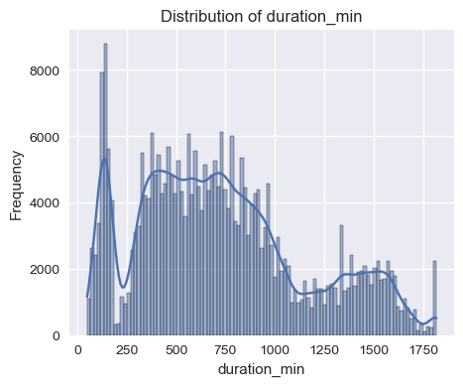
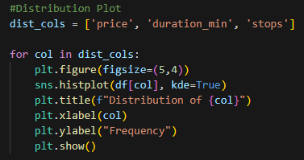
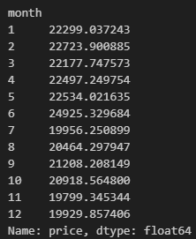
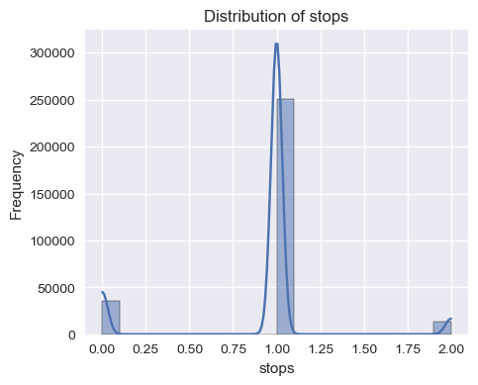
Most flights have 1 stop, moderate durations, and fall into lower-to-mid price ranges, indicating common connecting routes dominate the dataset.
Flight duration and number of stops vary widely, leading to significant differences in ticket prices across routes.
Most flights have 1 stop, moderate durations, and fall into lower-to-mid price ranges, indicating common connecting routes dominate the dataset.

Slide 14
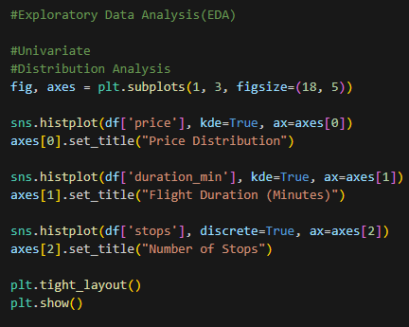
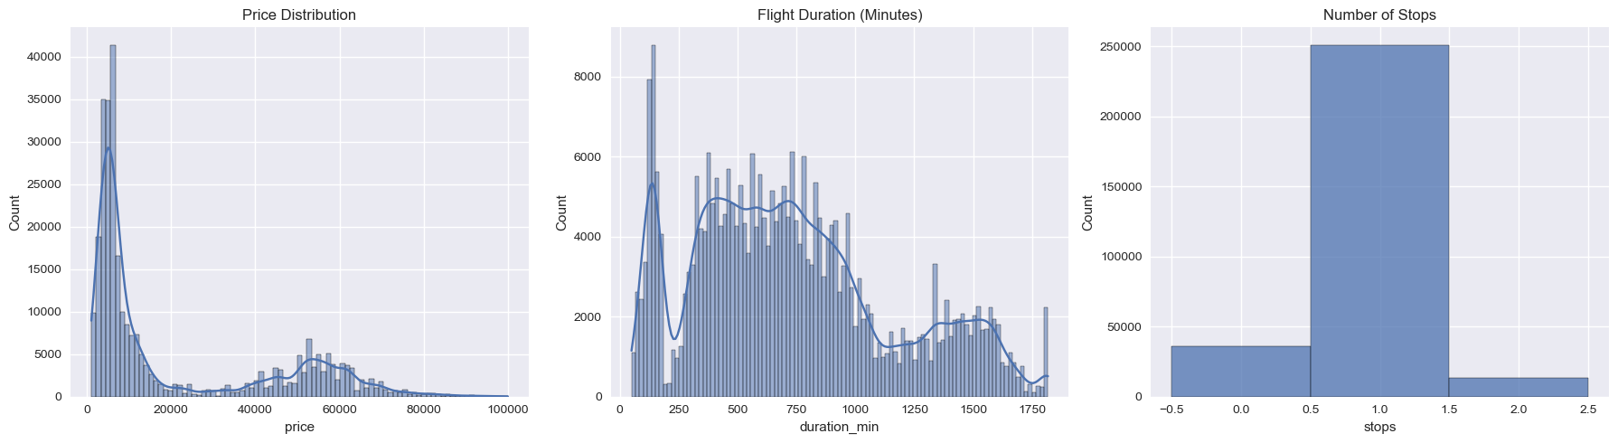
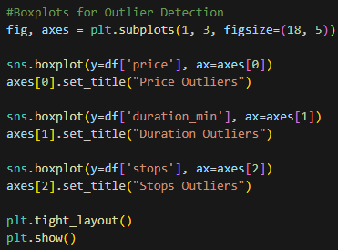
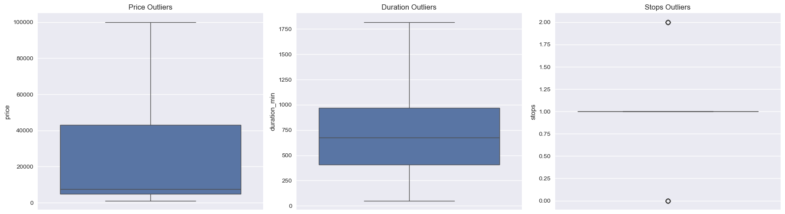
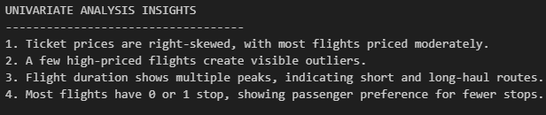
EDA Analysis
1. Univariate Analysis

Slide 15
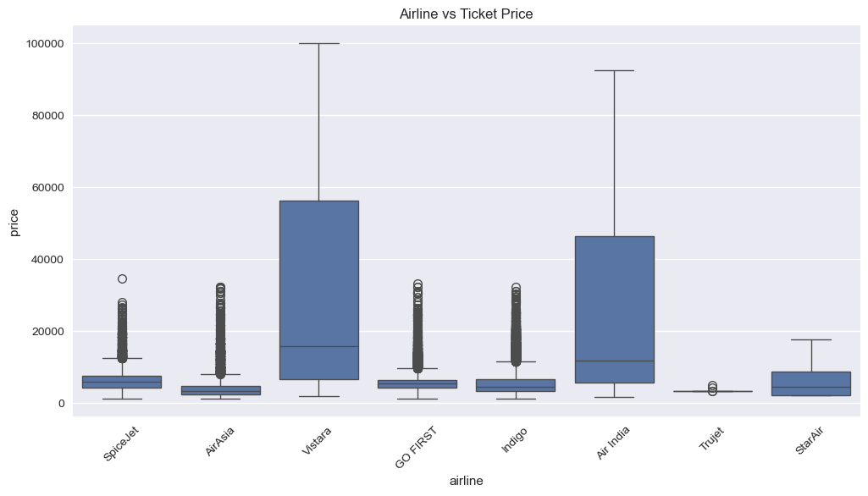
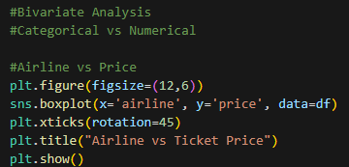
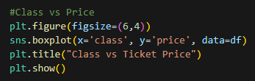
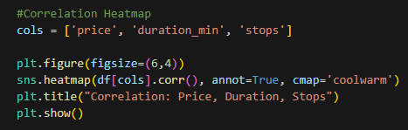
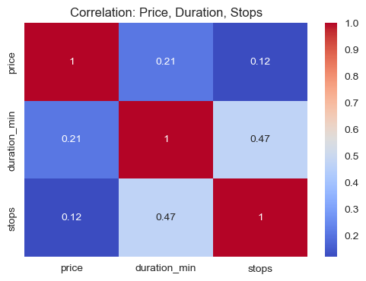
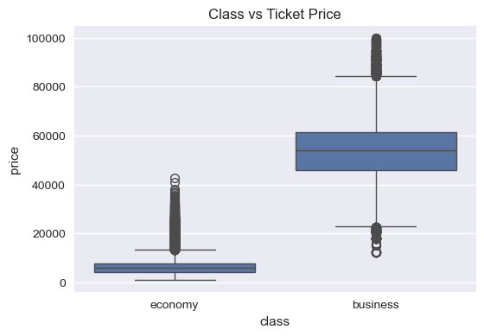
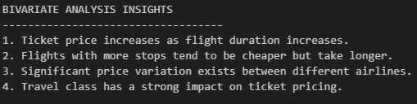
2. Bivariate Analysis

Slide 16

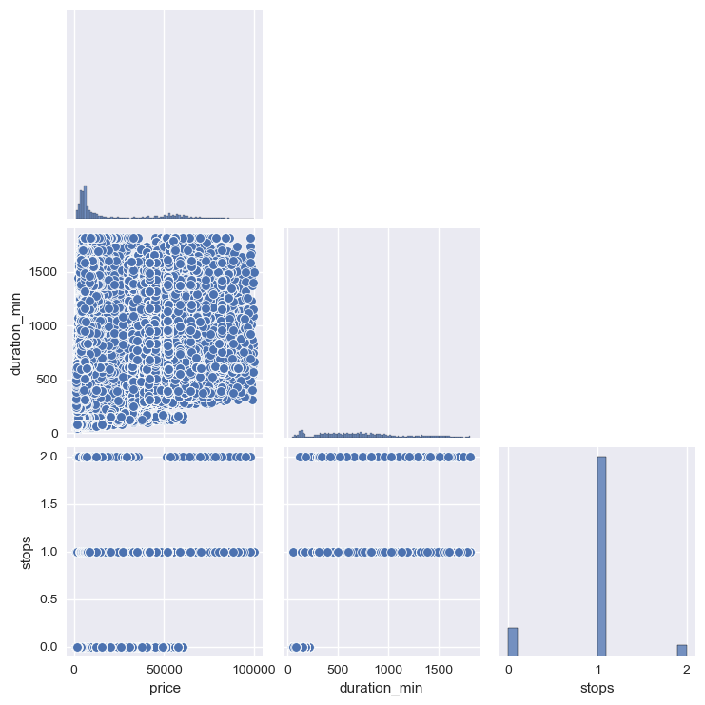
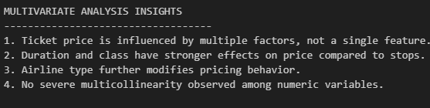

3. Multivariate Analysis

Slide 17
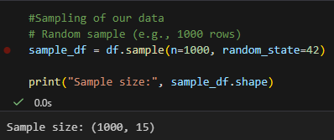
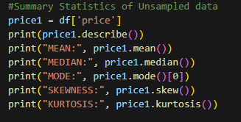
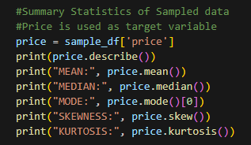


Sampling and applying CLT to our data
#Mean > Median → Right skewed
#Positive skewness → Long tail on right
#High kurtosis → Presence of extreme values
#Insigts
#The sample closely matches the full dataset in mean, median, skewness, and kurtosis, confirming that the sampling is representative and reliable.
#Both datasets show a right-skewed price distribution, indicating that higher-priced flights influence the overall pricing pattern consistently.

Slide 18






Slide 19





#Insights
#Density plots confirm that ticket price follows a right-skewed distribution.
#The sampled data maintains the same distributional shape as the full dataset.
#KDE plots provide a clearer view of skewness compared to histograms.

Slide 20







Slide 21



Hypothesis testing and applying t-test
#Hypotheses testing
#Two-tailed t-test (most appropriate)
#H₀ (Null Hypothesis):
#Mean price of Economy = Mean price of Business
#H₁ (Alternative Hypothesis):
#Mean price of Economy ≠ Mean price of Business
#Two-tailed because:
#We are checking for any difference, not direction-specific
#A two-tailed one-sample t-test is used with a significance level(alpha) of 0.05.
#Interpretation:
#T-statistic = -1073.42
#Negative because Economy mean < Business mean (t-test subtracts Business − Economy by default).
#P-value ≈ 0
#Extremely small, effectively zero →
# the difference in mean prices between Economy and Business is highly statistically significant.

Slide 22



Slide 23





Data preparation for ML Model

Slide 24








#Insights or Interpretation
# The correlation matrix shows that ticket price is moderately correlated with flight duration and number of stops.
# Airline and class also influence pricing, while route-based features show weaker linear relationships.
# No extreme multicollinearity was observed among predictors.

Slide 25




Slide 26





Applying Linear Model

Slide 27



#MSE = 0.00537 → The average squared error is very small relative to the scaled target (0–1).
#MAE = 0.049 → On average, predictions are off by ~4.9% of the total price range.
#RMSE = 0.073 → Typical prediction error magnitude is ~7.3% of the price range,
# slightly higher than MAE due to some larger errors/outliers.
#R² = 0.901 → The model explains ~90% of the variance in ticket prices, which indicates a very good fit.
#Conclusion: The Linear Regression model predicts flight prices accurately and reliably, with small relative errors.

Slide 28








Slide 29





Slide 30





Slide 31





Slide 32


#Summary of Insights from Visualizations
#Ticket price depends strongly on class, airline, duration, and stops.
#Model residuals are mostly small → predictions are accurate.
#Some extreme high-price flights cause larger errors → could explore outlier treatment.
#Visualizations make your ML project more interpretable for stakeholders.

Slide 33




Modelling Through AI(Google Collab/Gemini)
Label Encoding, MinMax Scaler.
T-test is used.
Logistic Regression Model is applied.

Slide 34
Conclusion
In this project, airline flight ticket data was analyzed to understand the factors influencing ticket prices and to build a predictive model. The dataset was first explored and cleaned by handling data types, removing irrelevant features, and ensuring data consistency. Exploratory Data Analysis revealed that flight duration, travel class, airline, and number of stops have a noticeable impact on pricing, while raw date and identifier columns contributed little predictive value.
Statistical analysis and sampling techniques confirmed that flight prices are right-skewed, and the Central Limit Theorem was validated using sampling distributions. A Linear Regression model was then developed as a baseline predictive model. The model demonstrated moderate explanatory power, with acceptable error metrics, indicating that it can reasonably estimate flight prices based on selected features.
Overall, the project successfully combines data preprocessing, statistical analysis, exploratory visualization, and machine learning to derive meaningful insights from airline data. The model provides an interpretable and reliable foundation, which can be further improved using advanced regression or ensemble techniques in future work.

Slide 35
thank you

